Slide 1
Development and Implementation of Chatbot using Machine Learning
PIP2001 Capstone Project
Final Review
Batch Number: CSE07
Roll Number | Student Name
Chakshu | 20211CSE0146
Choleshwar Kumar | 20211CSE0006
Amarjeet Kumar | 20211CSE0007
Bhanu Prakash Reddy | 20211CSE0108
Samrat Sarkar | 20211CSE0098
Under the Supervision of,
Dr. Iqbal Gani Dar
Assistant Professor
School of Computer Science and Engineering
Presidency University, Bengaluru
Name of the Program: B.Tech
Name of the HoD: Dr.Asif Mohammed
Name of the Program Project Coordinator: Mr.Amarnath J L ( AP) / Dr. Jayanthi Kamalasekaran
Name of the School Project Coordinators: Dr. Sampath A K / Dr. Abdul Khadar A / Mr. Md Ziaur Rahman

Slide 2
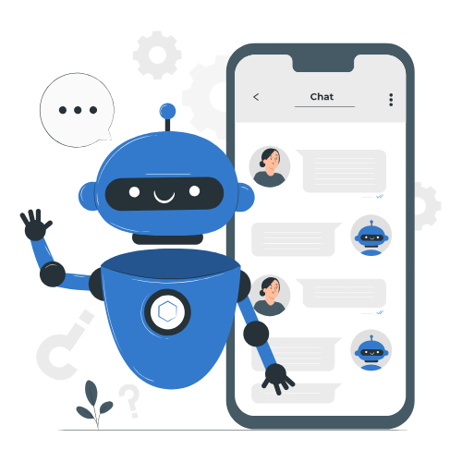
Introduction
A human-computer discourse framework, the frame of chatbots that work through normal dialect preparing. It utilizing either content or discourse, is a mechanized framework, which ordinarily runs 24/7, and its essential utilize is driving transformation; it is implied to handle millions of demands per hour. Chatbots are a group of intelligent, conversational computer programs that are activated by input in a distinctive vernacular. They are able to understand input, execute tasks, and receive commands. Indeed, even though chatbots have been around for a while, they are becoming more advanced due to open-source development platforms, increased preparation control, along with data accessibility.

Slide 3
Literature Review
Here, the factors are based on which feelings are classified using artificial intelligence techniques. Using convolutional neural networks, deep learning, and repeated neural networks (RNNs), the researchers develop models for classifying emotions from a portion of identified data. When using Natural Language Generation (NLG) and Characteristic Dialect Handling (NLP) to guide client discussions, etymological interaction is crucial. Here, voice and content acknowledgment are used in a multi-modal strategy. They have gathered corpuses to help them learn the semantic information of words and speak to them as vectors. They have also gathered information about lexical equivalents of words. [1]

Slide 4
Objectives
Natural Language Understanding (NLU) and Context Awareness
Create methods to improve memory retention and enable better adaptation to context.
Emotional Intelligence and Personalization
Incorporate emotion-detection models and sentiment analysis to enable the chatbot to provide more empathetic responses.
Bias and Ethical Concerns
Improve datasets and training processes to minimize biases.
Language and Cultural Adaptability
Expand language support, including underrepresented or regional languages.

Slide 5
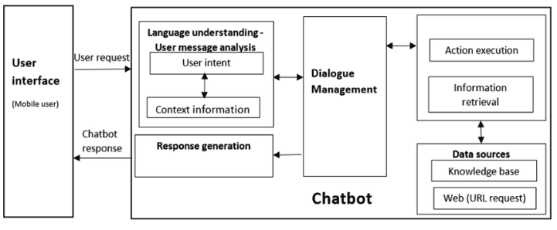
System Architecture

Slide 6
Methodology
Analysis of Requirements
Conduct literature review to identify gaps and best practices in disaster management.
System Design
Architectural Design:
Define database, frontend, and backend components.
Database Design:
Use MySQL to manage relief materials (types, quantities, status).
User Interface Design:
Design wireframes/mockups with Adobe XD or Figma for intuitive navigation.
Technology Stack Selection
Frontend:
Use React JS for responsive, user-friendly interface.
Backend:
Use Node.js/Express for API management and data integration.
Real-Time Information:
Integrate Firebase for real-time updates on supplies.

Slide 7
Expected Outcomes
Customer Support:
Faster resolution of customer queries.
24/7 availability for answering frequently asked questions.
Reduced workload for human agents, allowing them to handle complex queries.
Sales and Marketing:
Increased lead generation through proactive engagement.
Enhanced user experience with personalized recommendations.
Automation of product or service inquiries.
Healthcare:
Quick access to health-related information and resources.
Support for appointment scheduling and reminders.

Slide 8
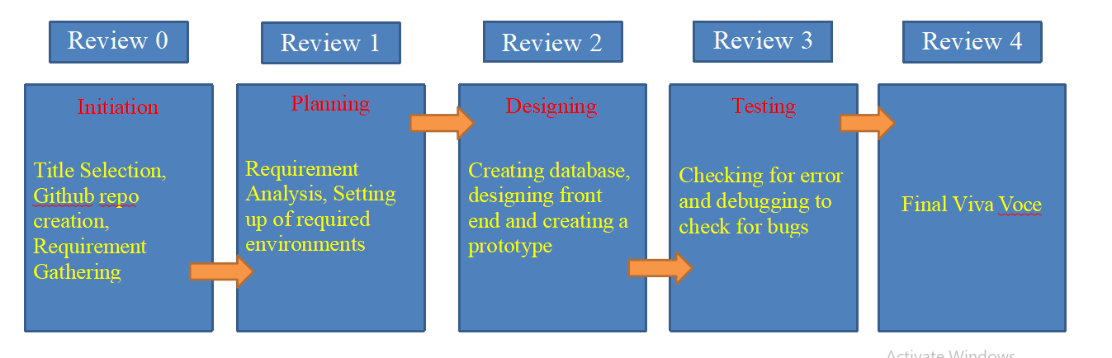
Timeline of the Project(Gantt Chart)

Slide 9
Conclusion
The aim of the paper is to create a framework that demonstrates high-quality responses in the shortest amount of time. As a result, the user is relieved of the stress of having an expert respond to their question directly. This program saves time while seeking a solution from a specialist or doctor for medical issues. program to extract the user query's keyword utilizing the TF-IDF and N-gram. To choose the appropriate response for the inquiry, each keyword is weighed down. The Web interface is designed to allow users to enter their queries. Upgrades to the application's efficacy and security make it better. Future chatbots will learn user preferences, habits, and behavior to provide more tailored experiences.

Slide 10
Reference
K. Oh, D. Lee, B. Ko and H. Choi, "A Chatbot for Psychiatric Counseling in Mental Healthcare Service Based on Emotional Dialogue Analysis and Sentence Generation," 2017 18th IEEE International Conference on Mobile.
Du Preez, S.J. & Lall, Manoj & Sinha, S. (2009). An intelligent webbased voice chat bot. 386391.10.1109/EURCON.2009.5167660
Dahiya, Menal. (2017). A Tool of Conversation: Chatbot. INTERNATIONAL JOURNAL OF COMPUTER SCIENCES AND ENGINEERING. 5. 158-161.2017.
E. Adamopoulou and L. Moussiades, “Chatbots: History, technology, and applications,” Machine Learning with Applications, vol. 2, p. 100006, 2020.

Slide 11


